Slide 1

96 Great Suffolk Street
London, United Kingdom
SE1 0BE

Slide 2
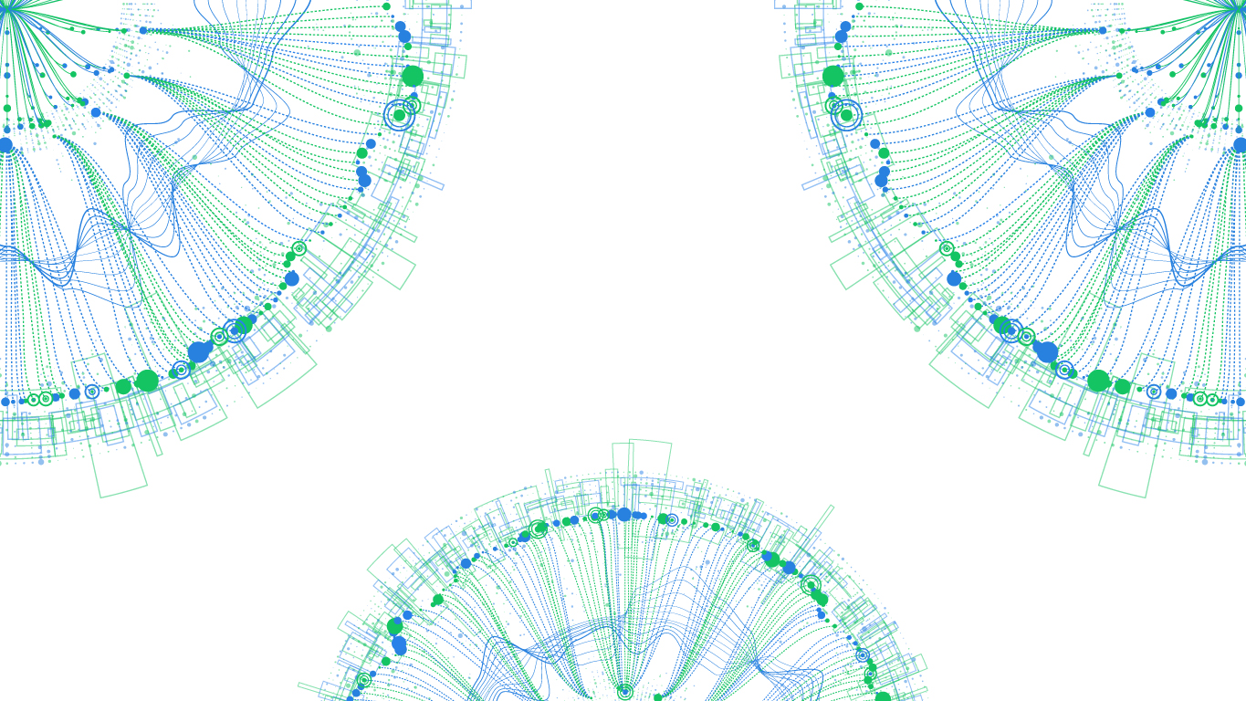

JLR Project:
I-Pace Projection UK Sales FY2019
Amber Rigg

Slide 3


Data Team
Amber Rigg
BIG DATA ENGINEER – KUBRICK GROUP, LONDON November 2018 – present
UNIVERSITY OF ST. ANDREWS, MCHEM(HONS) CHEMISTRY
September 2013 – June 2018
Ellen O’Neil
BIG DATA ENGINEER – KUBRICK GROUP, LONDON November 2018 – present
UNIVERSITY OF LEESD, MCHEM(HONS) CHEMISTRY (International)
September 2014 – June 2018

Slide 4
Task – Project UK Sales of I-Pace FY2019
Task
To project a forecast of sales for Fiscal Year 2019 (Apr 2019 / March 2020) for the Jaguar I-Pace all electric SUV.
Issues
The use of previous sales in forecasting is impossible as this “white space” vehicle has only one quarter of sales.
Jaguar currently sells no comparable models.
Excessive new releases makes the BEV market unpredictable.
Result
The development of an alternative method for forecasting sales volume of the I-Pace for FY2019 in the United Kingdom .
The alternative model can be combined with existing methods to determine production volumes and the volumes sent to different markets.

Slide 5
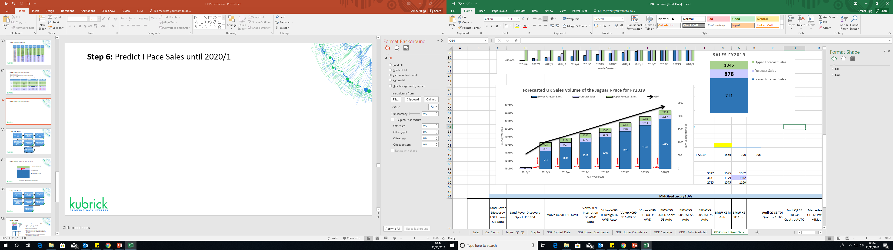
Result - Projected UK Sales of I-Pace FY2019
Strong Reliable Model based on European Commission GDP Forecast.
Model Accounts for Acceptance Sales and Error.
Harnesses Reliable UK Data Sources.

Slide 6
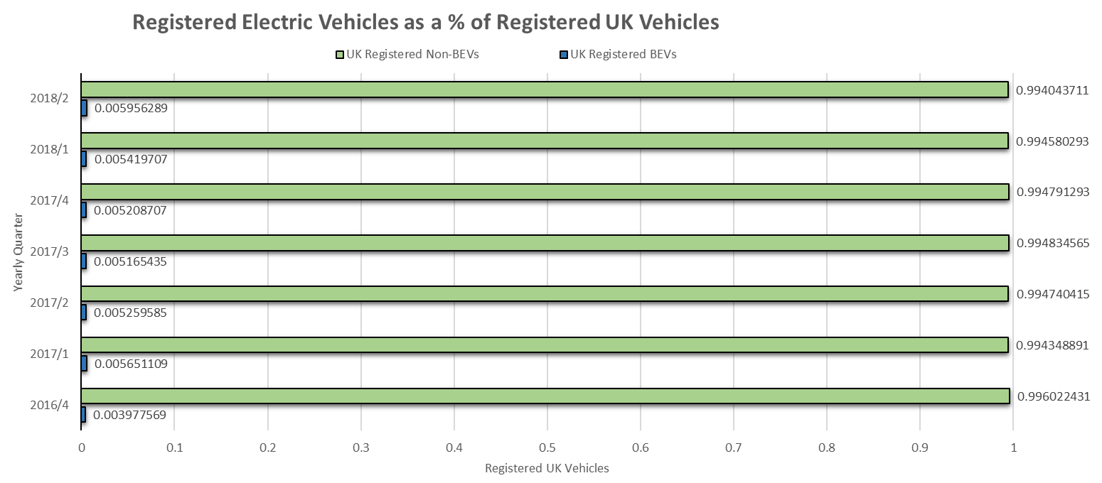
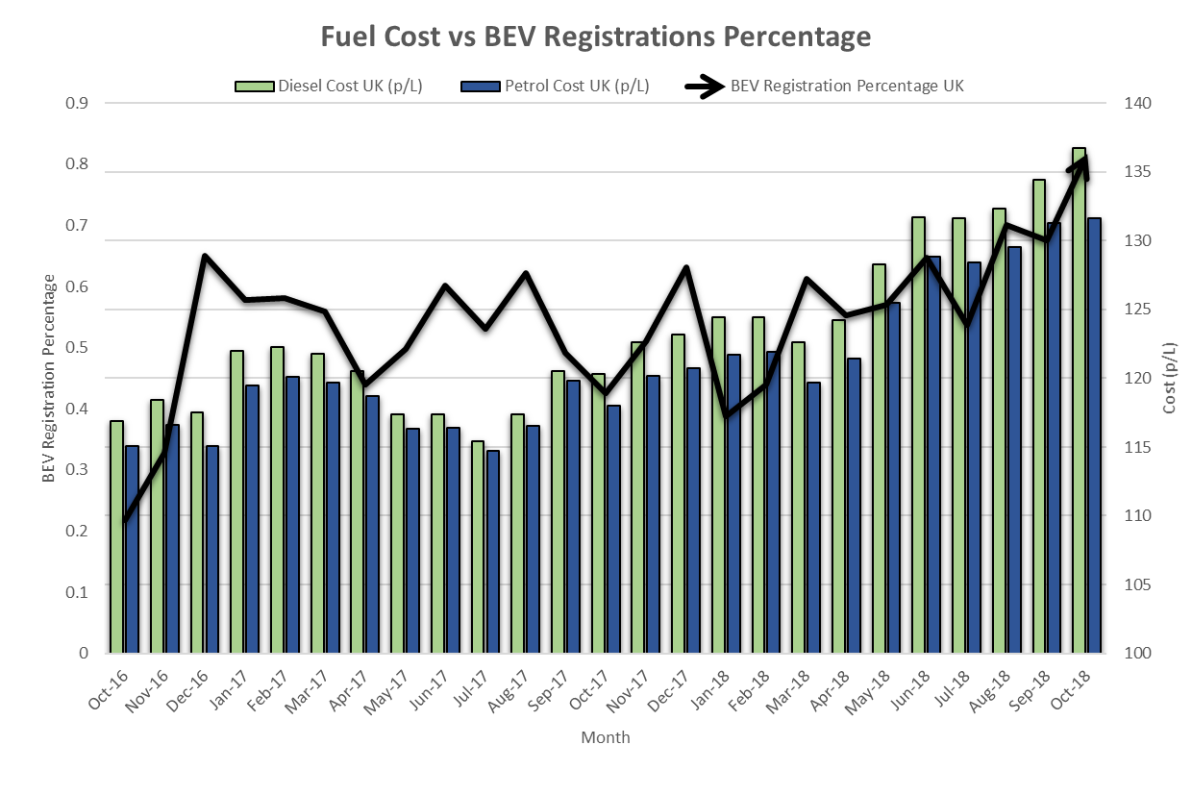
Analysing BEV Sales
Chargemaster forecasts one million electric cars on UK roads by 2022.
By 2030 it is predicted that 60% of new cars will be electric .
As fuel costs increase the percentage of UK BEV Registrations has also increased.
More than 30 new electric models are coming to market by 2020 giving consumers choice but increasing competition.

Slide 7
Choosing a Model
All data used is for the United Kingdom.
Possible Models:
UK Brand Awareness for FY2016/17
Inflation Rate UK vs BEV Registrations UK
UK Net Disposable Income per capita vs BEV UK Registrations
UK Fuel Cost vs BEV UK Registrations
UK GDP vs BEV UK Registrations
Comparison BEV Vehicles
Car | Price | Battery Capacity | Real Range | Efficiency
I-PACE EV400 HSE | £59,995 | 85.0 kWh | 235 mi | 360 Wh/mi
BMW i3 120Ah | £31,675 | 37.9 kWh | 145 mi | 260 Wh/mi
Tesla Model X 75 D | £78,000 | 75.0 kWh | 210 mi | 345 Wh/mi
Tesla model X P110D | £95,150 | 94.0 KWh | 260 mi | 360 Wh/mi

Slide 8
Choosing a Model
Unsuitable Model
→ No trend for Jaguar observed

Slide 9
Choosing a Model
Unsuitable Model
→ No correlation observed

Slide 10
Choosing a Model
Unsuitable Model
→ Approx. weak correlation of 0.3

Slide 11
Choosing a Model
Possible Model
→ Approx. Correlation 0.8

Slide 12
Choosing a Model
Chosen Model
Strong approx. correlation of 0.98.
The registration of commercial vehicles follows the growth of GDP as demand for road transport is related to the state of the economy.

Slide 13
7 Step GDP Model
Step 1: Calculate Relationship between BEV Registrations and GDP
Step 2: Forecast GDP
Step 3: Predict Future BEV Registrations based on Forecasted GDP
Step 4: Predict I-Pace Sales from Predicted Future BEV Registrations
Step 5: Account for Acceptance Sale
Step 6: Project I-PACE Sales until 2020/1
Step 7: Calculate Total I-Pace Sales in FY2019

Slide 14
Step 1: Calculate Relationship between BEV Registrations and GDP
Plotting GDP against a Car Models BEV Registrations allows for a line of best fit to be plotted.
An equation to determine the no. Sales depending on GDP can then be successfully derived for each car model.
Model | Equation
Tesla X 75D | Sales = 0.00000534748618854819GDP² - 5.15133739455078000000GDP + 1,240,509.05562289000000000000
Tesla X P100D | Sales = 0.00000006996578157462GDP² - 0.04436387807905510000GDP + 5,125.87803119847000000000
BMW | Sales = -0.000002887039285739190GDP² + 2.958595143648500000000GDP - 754,279.581280185000000000000

Slide 15
Step 2: Forecast GDP
Excel Forecast Function: uses data provided to extrapolate potential future data harnessing liner regression.
Triple exponential smoothing (ETS) weights the values in your series so that more recent values are more heavily weighted and further past values are less weighted.
Confidence Interval: 95%

Slide 16
Step 3: Predict Future BEV Registrations based on Forecasted GDP

Slide 17

7 Step GDP Model
Step 1: Calculate Relationship between BEV Registrations and GDP
Step 2: Forecast GDP
Step 3: Predict Future BEV Registrations based on Forecasted GDP
Step 4: Predict I-Pace Sales from Predicted Future BEV Registrations
Step 5: Account for Acceptance Sale
Step 6: Project I-PACE Sales until 2020/1
Step 7: Calculate Total I-Pace Sales in FY2019

Slide 18
Step 2: Forecast GDP
European Commission GDP Forecast
Quarter | Growth (%) | GDP (£/Million)
2016/4 | 0.7 | 485 897
2017/1 | 0.3 | 487 422
2017/2 | 0.2 | 488 624
2017/3 | 0.5 | 490 876
2017/4 | 0.4 | 492 785
2018/1 | 0.1 | 493 278
2018/2 | 0.4 | 495251
2018/3 | 0.5 | 497727
2018/4 | 0.3 | 499221
2019/1 | 0.3 | 500718
2019/2 | 0.3 | 502220
2019/3 | 0.3 | 503727
2019/4 | 0.3 | 505238
2020/1 | 0.3 | 506754
Excel Forecast calculation relies solely upon known GDP values.
European Commission Forecast calculation is dependent on known GDP and several external factors.
The European Commission is a trusted source.
→ More Reliable Forecast
Can accuracy be improved further?
Known Data
Forecasted Data

Slide 19
Step 2: Forecast GDP
European Commission GDP Forecast and Known 2018/3 GDP
Quarter | Growth (%) | GDP (£/Million)
2016/4 | 0.7 | 485 897
2017/1 | 0.3 | 487 422
2017/2 | 0.2 | 488 624
2017/3 | 0.5 | 490 876
2017/4 | 0.4 | 492 785
2018/1 | 0.1 | 493 278
2018/2 | 0.4 | 495251
2018/3 | 0.6 | 498223
2018/4 | 0.3 | 499717
2019/1 | 0.3 | 501216
2019/2 | 0.3 | 502720
2019/3 | 0.3 | 504228
2019/4 | 0.3 | 505741
2020/1 | 0.3 | 507258
2018/3 GDP Growth is a now a known value.
2018/3 GDP value is higher than predicted attributed to our booming summer.
Addition of 2018/3 GDP allows for a more accurate GDP value forecast.
Known Data
Forecasted Data

Slide 20
7 Step GDP Model
Step 1: Calculate Relationship between BEV Registrations and GDP
Step 2: Forecast GDP
Step 3: Predict Future BEV Registrations based on Forecasted GDP
Step 4: Predict I-Pace Sales from Predicted Future BEV Registrations
Step 5: Account for Acceptance Sale
Step 6: Project I-PACE Sales until 2020/1
Step 7: Calculate Total I-Pace Sales in FY2019

Slide 21
Step 3: Predict Future BEV Registrations based on Forecasted GDP

Slide 22
7 Step GDP Model
Step 1: Calculate Relationship between BEV Registrations and GDP
Step 2: Forecast GDP
Step 3: Predict Future BEV Registrations based on Forecasted GDP
Step 4: Predict I-Pace Sales from Predicted Future BEV Registrations
Step 5: Account for Acceptance Sale
Step 6: Project I-PACE Sales until 2020/1
Step 7: Calculate Total I-Pace Sales in FY2019

Slide 23
Step 4: Predict I-Pace Sales from Predicted Future BEV Registrations
Car | Price | Battery Capacity | Real Range | Efficiency
I-PACE EV400 HSE | £59,995 | 85.0 kWh | 235 mi | 360 Wh/mi
BMW i3 120Ah | £31,675 | 37.9 kWh | 145 mi | 260 Wh/mi
Tesla Model X 75 D | £78,000 | 75.0 kWh | 210 mi | 345 Wh/mi
Tesla model X P110D | £95,150 | 94.0 KWh | 260 mi | 360 Wh/mi
All three BEV with varying Prices observe strong correlation between the GDP and their registrations.
Tesla Model X 75D is the best comparison: comparable price, battery capacity, real range and efficiency hence same consumers.
Tesla is a known BEV distributor however Jaguar is a known UK distributer. Both would perform equally well within the UK BEV Market.

Slide 24
Step 4: Predict I-Pace Sales from Predicted Future BEV Registrations
Quarter | Growth (%) | GDP (£/Million) | Tesla Model X 75D Sales | % Change | I-PACE EV400 HSE Sales
2016/4 | 0.7 | 485 897 | 2 | n/a | 0
2017/1 | 0.3 | 487 422 | 96 | n/a | 0
2017/2 | 0.2 | 488 624 | 184 | n/a | 0
2017/3 | 0.5 | 490 876 | 363 | n/a | 0
2017/4 | 0.4 | 492 785 | 534 | n/a | 0
2018/1 | 0.1 | 493 278 | 671 | n/a | 0
2018/2 | 0.4 | 495251 | 785 | n/a | 43
2018/3 | 0.6 | 498223 | 1380 | +85% | 80
2018/4 | 0.3 | 499717 | 1657 | +20% | 95
2019/1 | 0.3 | 501216 | 1958 | +18% | 113
2019/2 | 0.3 | 502720 | 2285 | +17% | 132
2019/3 | 0.3 | 504228 | 2637 | +15% | 152
2019/4 | 0.3 | 505741 | 3014 | +32% | 201
2020/1 | 0.3 | 507258 | 3417 | +50% | 302
Known Data
Forecasted Data

Slide 25
7 Step GDP Model
Step 1: Calculate Relationship between BEV Registrations and GDP
Step 2: Forecast GDP
Step 3: Predict Future BEV Registrations based on Forecasted GDP
Step 4: Predict I-Pace Sales from Predicted Future BEV Registrations
Step 5: Account for Acceptance Sale
Step 6: Project I-PACE Sales until 2020/1
Step 7: Calculate Total I-Pace Sales in FY2019

Slide 26
Step 5: Account for Acceptance Sale
Quarter | Growth (%) | GDP (£/Million) | Tesla Model X 75D Sales | % Change | I-PACE EV400 HSE Sales | I Pace Sales Quarter
2016/4 | 0.7 | 485 897 | 2 | n/a | 0 | -
2017/1 | 0.3 | 487 422 | 96 | n/a | 0 | -
2017/2 | 0.2 | 488 624 | 184 | n/a | 0 | -
2017/3 | 0.5 | 490 876 | 363 | n/a | 0 | -
2017/4 | 0.4 | 492 785 | 534 | n/a | 0 | -
2018/1 | 0.1 | 493 278 | 671 | n/a | 0 | -
2018/2 | 0.4 | 495251 | 785 | n/a | 43 | Q1
2018/3 | 0.6 | 498223 | 1380 | +85% | 80 | Q2
2018/4 | 0.3 | 499717 | 1657 | +20% | 95 | Q3
2019/1 | 0.3 | 501216 | 1958 | +18% | 113 | Q4
2019/2 | 0.3 | 502720 | 2285 | +17% | 132 | Q5
2019/3 | 0.3 | 504228 | 2637 | +15% | 152 | Q6
2019/4 | 0.3 | 505741 | 3014 | +32% | 201 | Q7
2020/1 | 0.3 | 507258 | 3417 | +50% | 302 | Q8
Can the model be improved?
It is important to account for a spike of sales between the first and second quarter as the new product is widely accepted.
The current % change of sales between the first and second quarter is incorrect.

Slide 27
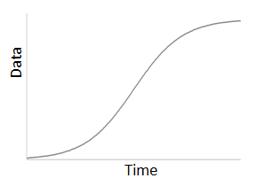
Step 5: Account for Acceptance Sale
Early Adopters 0-Q1
Acceptance Q1-Q2
Saturation Q2-present
The penetration of a new product will have 3 stages, Erly Adopters, Acceptnce and Saturation.
During Q1-Q2 a spike of sales would be expected as the new car is accepted.
The Q1-Q2 acceptance sale increase was derived by examining the Q1 and Q2 sales of a range of Mid-Sized Luxury SUVs and our examined BEV vehicles.
Q1-Q2 Predicted Sales Increase: +1631%
Sales
Mid-Sized Luxury SUVs
Land Rover Discovrey HSE Luxury SI4 Auto, Land Rover Discovery Sport HSE ED4, Volvo XC 90 T SE AWD, Volvo XC90 Inscription D5 AWD Auto, Volvo XC90 R-Design T6 AWD Auto, Volvo XC90 SE AWD D5, Volvo XC90 SE LUX D5 AWD, BMW X5 3.0SD Sport 5S Auto, BMW X5 3.0SD SE 5S Auto, BMW X5 3.0SD SE 7S Auto, BMW X5 M Auto,BMW X5 SE Auto, Audi Q7 SE TDI Quattro AUTO, Audi Q7 SE TDI 245 Quattro AUTO, Mercedes AMG GLE 43 Premium +4Matic A, Mercedes GLE 450 AMG PREMIUM 4MATIC A, Mercedes GLE 500 E 4M AMG Line Prem A
BEV
Tesla Model X75D, Tesla Model X P100D, BMW i3

Slide 28
7 Step GDP Model
Step 1: Calculate Relationship between BEV Registrations and GDP
Step 2: Forecast GDP
Step 3: Predict Future BEV Registrations based on Forecasted GDP
Step 4: Predict I-Pace Sales from Predicted Future BEV Registrations
Step 5: Account for Acceptance Sale
Step 6: Project I-PACE Sales until 2020/1
Step 7: Calculate Total I-Pace Sales in FY2019

Slide 29
Step 6: Project I-PACE Sales until 2020/1
Quarter | Growth (%) | GDP (£/Million) | Tesla Model X 75D Sales | % Change | I-PACE EV400 HSE Sales
2016/4 | 0.7 | 485 897 | 2 | n/a | 0
2017/1 | 0.3 | 487 422 | 96 | n/a | 0
2017/2 | 0.2 | 488 624 | 184 | n/a | 0
2017/3 | 0.5 | 490 876 | 363 | n/a | 0
2017/4 | 0.4 | 492 785 | 534 | n/a | 0
2018/1 | 0.1 | 493 278 | 671 | n/a | 0
2018/2 | 0.4 | 495251 | 785 | n/a | 48
2018/3 | 0.6 | 498223 | 1380 | +1631% | 831
2018/4 | 0.3 | 499717 | 1657 | +20% | 997
2019/1 | 0.3 | 501216 | 1958 | +18% | 1179
2019/2 | 0.3 | 502720 | 2285 | +17% | 1376
2019/3 | 0.3 | 504228 | 2637 | +15% | 1587
2019/4 | 0.3 | 505741 | 3014 | +32% | 2094
2020/1 | 0.3 | 507258 | 3417 | +50% | 3132
Known Data
Forecasted Data
Acceptance Sales Percentage

Slide 30
Step 6: Project I-PACE Sales until 2020/1
Accounting for Error:
Standard Error = Standard Deviation / (Total No. of Samples)^{1/2}
Standard Error = 167 Sales
Standard Error is used to determine the Upper and Lower Sales of each individual quarter.
Quarter | GDP Growth (%) | GDP (£/Million) | Tesla Model X 75D Sales | % Change | I-PACE EV400 HSE Sales | I-PACE EV400 HSE Lower Sales | I-PACE EV400 HSE Upper Sales
2016/4 | 0.7 | 485 897 | 2 | - | 0 | 0 | 0
2017/1 | 0.3 | 487 422 | 96 | - | 0 | 0 | 0
2017/2 | 0.2 | 488 624 | 184 | - | 0 | 0 | 0
2017/3 | 0.5 | 490 876 | 363 | - | 0 | 0 | 0
2017/4 | 0.4 | 492 785 | 534 | - | 0 | 0 | 0
2018/1 | 0.1 | 493 278 | 671 | - | 0 | 0 | 0
2018/2 | 0.4 | 495251 | 785 | - | 48 | 48 | 48
2018/3 | 0.6 | 498223 | 1380 | +1631% | 831 | 664 | 998
2018/4 | 0.3 | 499717 | 1657 | +20% | 997 | 830 | 1164
2019/1 | 0.3 | 501216 | 1958 | +18% | 1179 | 1012 | 1346
2019/2 | 0.3 | 502720 | 2285 | +17% | 1376 | 1208 | 1543
2019/3 | 0.3 | 504228 | 2637 | +15% | 1587 | 1420 | 1754
2019/4 | 0.3 | 505741 | 3014 | +14% | 1815 | 1647 | 1981
2020/1 | 0.3 | 507258 | 3417 | +13% | 2057 | 1890 | 2224

Slide 31
Step 6: Project I-PACE Sales until 2020/1
Final Forecast for the project sales of the I-PACE EV400 HSE from 2018/1 – 2020/1
Yearly Quarter | GDP (£/Million) | I-PACE EV400 HSE Sales | I-PACE EV400 HSE Lower Sales | I-PACE EV400 HSE Upper Sales
2018/1 | 493 278 | 0 | 0 | 0
2018/2 | 495251 | 48 | 48 | 48
2018/3 | 498223 | 831 | 664 | 998
2018/4 | 499717 | 997 | 830 | 1164
2019/1 | 501216 | 1179 | 1012 | 1346
2019/2 | 502720 | 1376 | 1208 | 1543
2019/3 | 504228 | 1587 | 1420 | 1754
2019/4 | 505741 | 1815 | 1647 | 1981
2020/1 | 507258 | 2057 | 1890 | 2224
Known Data
Forecasted Data

Slide 32
Step 6: Project I-PACE Sales until 2020/1

Slide 33
7 Step GDP Model
Step 1: Calculate Relationship between BEV Registrations and GDP
Step 2: Forecast GDP
Step 3: Predict Future BEV Registrations based on Forecasted GDP
Step 4: Predict I-Pace Sales from Predicted Future BEV Registrations
Step 5: Account for Acceptance Sale
Step 6: Project I-PACE Sales until 2020/1
Step 7: Calculate Total I-Pace Sales in FY2019

Slide 34
Step 7: Calculate Total I-Pace Sales in FY2019
Assumption: BEV registrations directly correlate to sales.

Slide 35
7 Step GDP Model
Step 1: Calculate Relationship between BEV Registrations and GDP
Step 2: Forecast GDP
Step 3: Predict Future BEV Registrations based on Forecasted GDP
Step 4: Predict I-Pace Sales from Predicted Future BEV Registrations
Step 5: Account for Acceptance Sale
Step 6: Project I-PACE Sales until 2020/1
Step 7: Calculate Total I-Pace Sales in FY2019

Slide 36
Model Review
All data used is related to the United Kingdom.
BEV Vehicle Registrations vs GDP model displayed the highest correlation.
GDP forecast is based on reliable European Commission Forecast and Known Data.
Early Adoption sales are known.
Predicted Acceptance I-Pace Sales has been projected by harnessing Acceptance Sales of Mid-Sized Luxury SUVs and BEV vehicles.
Predicted saturation I-Pace car sales have been modelled around the similar car Tesla Model X 75D.
Standard Error has been applied to derive both a Lower and Upper Forecast Sales from predicted Forecast Sale.
Early Adopters 0-Q1
Acceptance Q1-Q2
Saturation Q2-present
Sales

Slide 37
Sources – Reliable UK Data
UK Vehicle Registrations
The Society of Motor Manufacturers and Traders (SMMT) Vehicle Data
Numbers recorded on the last day of each quarter and covers United Kingdom including Northern Ireland.
UK GDP
Office for National Statistics
Numbers recorded on the last day of each quarter and covers United Kingdom including Northern Ireland.
Forecasted UK GDP
European Commission
Numbers are forecasted for the last day of each quarter and covers United Kingdom including Northern Ireland.
Inflation Rate UK
Office for National Statistics
Numbers recorded on the last day of each quarter and covers United Kingdom including Northern Ireland.
UK Net Disposable Income per capita
Office for National Statistics
Numbers recorded on the last day of each quarter and covers United Kingdom including Northern Ireland.
UK Fuel Cost
AA
Numbers recorded on the last day of each month and covers United Kingdom including Northern Ireland.
UK Brand Awareness
Google Trend
Google Trends computes how many searches have been done for a term relative to the total number of searches done on Google at the same time.

Slide 38
Potential Model Risk and Improvements
Risks
The I-Pace is a new product and Jaguar currently does not sell an equivalent vehicle for comparison.
I-Pace Forecasted Saturation Sales have been modelled on a competitors sales of a similar car.
The Model does not allow for any unexpected events such as natural disasters, political upset, etc.
Improvements
The Adaptable Model could be updated as GDP values and known sale value are added to provide a more accurate forecast as well as automating future analysis..
A more extensive range vehicles could be harnessed to model I-Pace Sales.

Slide 39
Increasing Sales
Currently Brand Awareness shows no trends or possible improvements.
Marketing Improvements could help to reach Upper Forecast Sales.
Royal I-Pace belonging to Prince Charles could be possible marketing opportunity.

Slide 40
Result - Projected UK Sales of I-Pace FY2019
Strong Reliable Model based on European Commission GDP Forecast.
Model Accounts for Acceptance Sales and Error.
Harnesses Reliable UK Data Sources.

Slide 41
Thank you
Any questions?

